Slide 1


Comparative Investment Guide
TEAM 6
Notes:
Change metric titles - imply a story that si going to be told
Operations process- PATENTS cost return on RAnd D effectively
Drugs that have been successful in products
PNG all the logos and put it in the corner of the slide its talking about
TELL A STORY ALL TITLES NEED TO BE CHANGED
What is the purpose of each slide- why is this interesting? What is this telling me
BOLD each slide words and enlarge- I CAN’T READ ANYTHING FROM BACK OF THE ROOM TOO MANY WORDS_ MORE PICTURES
STOP WITH ALL OF THE COLORS - ONLY 3 ON EACH SLIDE
PATENTS NEED TO BE DISCUSSED hige thing in bio tech
Where is operation process? Needs to be discussed
There was a dip in the graph because of COVID- why??? Put them on the same slide so you can compare and contrast for slide #24 and #25
[delete those decorations; font]

Slide 2





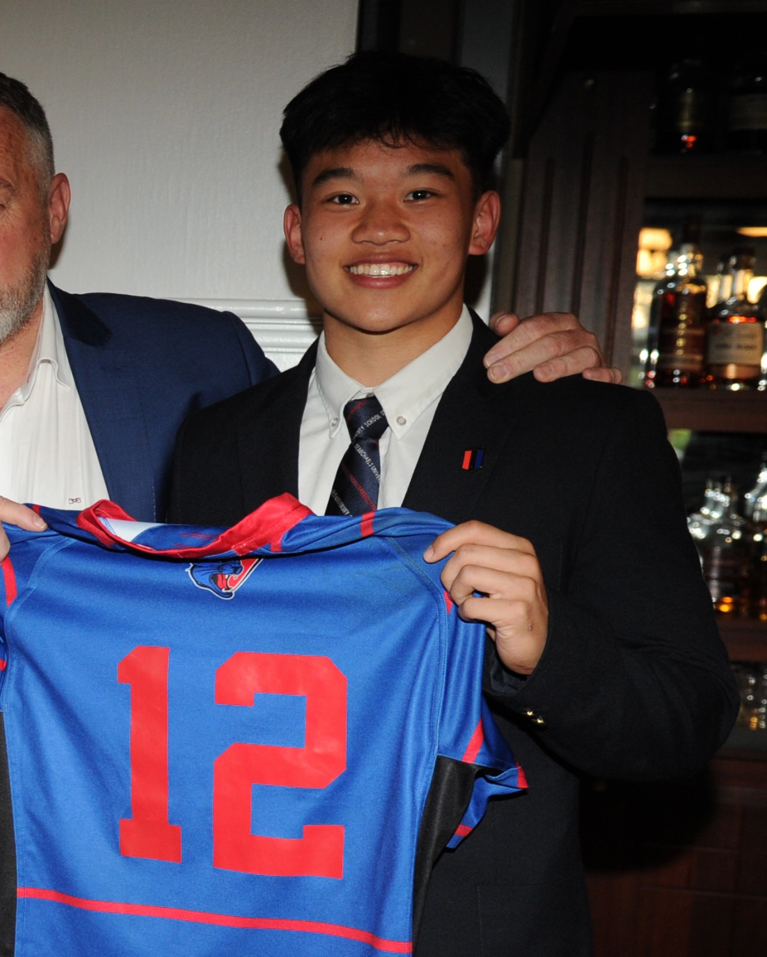


OUR TEAM
Adelene Jeneid
Scarlett Mandil
Anmar Abdi
Betty Wang
Alex Liu
Derek Nan
Notes:
names

Slide 3
TABLE OF CONTENTS
Principled Leadership
Sustainability Stewardship
Efficiency Optimization
Patient Value
Financial Stability
30%
20%
25%
15%
10%
Place, People, Partnership & process
Capturing value & Product
Leverage landscape, profitability
& R&D takeovers
Diversity, Promises & the reality
A greener Biotech & stronger community

Slide 4
COMPETITIVE INDUSTRY FUELED
BY INNOVATION
1. The industry is having healthy growth, encouraging new entrants
2. Existing big companies willing to collaborate
3. Not many medicines for rare disease
4. Buyers have low power over prices due to novelty
5. Biotech companies have the freedom to choose quality and price
6. Biotech companies have moderate competition
Notes:
[re-evaluate point 1,5,6]
Ask about #6

Slide 5
OVERVIEW
Genetic Diseases
Cancer
Cancer
Autoimmune Disorders
Targets
ESG Rating
A
BBB
Pipeline
300+ employees
Pipeline
200+ employees
Company Model
$2.04 Billion
$1.16 Billion
Market Cap
Notes:
Before this make a
Off center move it to the left
[l type of technology used by companies- out scenter]

Slide 6

01
EFFICIENCY OPTIMIZATION
Efficiency Optimization
Patient Value
Financial Stability
Principled Leadership
Sustainability Stewardship

Slide 7
POWER OF THE LOCATION
4/5
4/5
4/5
Close to different universities
&
within a major biotech hub results in high competition
Cambridge, Massachusetts
Pasadena, CA and San Diego, CA
Efficiency Optimization
Patient Value
Financial Stability
Principled Leadership
Sustainability Stewardship
Notes:
Off center
Move this down headline and enlarge
[stuffs are off center]
Advantage and disadvantage
Change title

Slide 8




EMPOWERING PROGRESS TOGETHER
4/5
4/5
3/5
Robust pipeline with various drugs in clinical development
Uses their platform to expand cancer treatments using adoptive cell therapy
Their SORT platform allows for direct delivery of genetic medicines to the organs
Their NK cell platform introduces genetic modifications improving functionality and effectiveness
Operational
Management
Efficiency Optimization
Marketing Strategy
Patient Value
Finances
Financial Stability
Ethics and
Governance
Principled Leadership
Environmental and Social
Sustainability Stewardship

Slide 9




EMPOWERING PROGRESS TOGETHER
4/5
3/5
4/5
Providing services over 50 countries,
6 medicines for 7 rare diseases
Cover services over 100+ countries and does research on broad variety of drugs
An international company across America, Europe, and Asia
One of the major companies & founder in the industry
Efficiency Optimization
Patient Value
Financial Stability
Principled Leadership
Sustainability Stewardship
Notes:
Score card is not clear(only have it on the 7th slides)
Consistent formatting

Slide 10
PIPELINE FOR PARTNERSHIPS
3.5/5
3.5/5
Pre-Clinical Trials
Identification
Clinical Trial
Release
1
2
3
4
Identify and validate potential targets for CRISPR Therapy
Lab dish and animal trials to study safety and effects
3 stages of clinical trials to assess safety and effectiveness
FDA approval and potential use
Efficiency Optimization
Patient Value
Financial Stability
Principled Leadership
Sustainability Stewardship
Notes:
Copy and paste the circle
Xencor-partnership[partnering for execution]
Intellia-drug launch[launching drug…]
(make it clear-using headlines)
Clear thatc xencor ants a license and intellia wants to actually launch projects

Slide 11
PIPELINE FOR PARTNERSHIPS
3.5/5
R&D XmAb Protein
Platform
Collaborate
Clinical Trial
1
2
3
Xencor has the Protein Platform can combine with other medicines
Other companies use the platform to develop/enhance medicines
The medicines have to experience three phases on trial
Efficiency Optimization
Patient Value
Financial Stability
Principled Leadership
Sustainability Stewardship

Slide 12
EFFICIENCY OPTIMIZATION SCORE
Place
4/5
4/5
Partnership
3/5
4/5
Process/Pipeline
3.5/5
3.5/5
Total
3.5/5
3.8/5
Efficiency Optimization
Patient Value
Financial Stability
Principled Leadership
Sustainability Stewardship
Notes:
Xencor is generally a more stable company through a financial lens. Would be a better investment because more diverse products and more partnerships. Intellia on the other hand is a more specialized company which makes it harder to find collaborators, leading them to take on more capital through debt. (riskier especially when they are researching and messing with genes)
[scores should be on single slides]
Check formatting-line should be same length

Slide 13

02
PATIENT VALUE
Efficiency Optimization
Patient Value
Financial Stability
Principled Leadership
Sustainability Stewardship

Slide 14
UNDERTREATED MARKET SEGMENT
4/5
4/5
Segmentation
Targeting
Positioning
1
2
3
Patients with specific genetic disorders
Patients with extremely rare and life threatening genetic diseases
Increase usage of gene therapy and increase availability of treatments
Efficiency Optimization
Patient Value
Financial Stability
Principled Leadership
Sustainability Stewardship
Notes:
What type of conditions same as slide 17 #2
[format should be the same; Intellia-commercialize; xencor…]
Targeting point is very obvious

Slide 15
INTELLIA PRODUCTS
3.5/5
3/5
CRISPR (Gene Editing)
NTLA-3001, for genetic disorder leading to lung disease
NTLA-2002, for disease causing severe and sudden swelling
NTLA-2001 w/ Regeneron, for disease affecting nerves and heart
Late Stage Research
Late Stage 2 Clinical Trials
Stage 3 Clinical Trials
Efficiency Optimization
Patient Value
Financial Stability
Principled Leadership
Sustainability Stewardship
Notes:
Center the text

Slide 16
UNDERTREATED MARKET SEGMENT
4/5
4/5
Segmentation
Targeting
Positioning
1
2
3
Segment the market based on the diseases
Selecting the patients with similar type of cancer
For specific cancer to R&D specific treatment
Efficiency Optimization
Patient Value
Financial Stability
Principled Leadership
Sustainability Stewardship

Slide 17
XENCOR PRODUCTS
4/5
XmAb Protein Platform
Ultomiris by Alexion, to empower the medicine
AMG 509 by Amgen, for prostate cancer treatment
Co-developing XmAb 306 with Genentech, for myeloma.
Got approved by EU and Japan
On clinical trial 1
On clinical trial 1
Efficiency Optimization
Patient Value
Financial Stability
Principled Leadership
Sustainability Stewardship

Slide 18
PATENTS
1/5
4/5
Patents provide exclusive rights for technology offering a greater competitive advantage
40
1300+
Efficiency Optimization
Patient Value
Financial Stability
Principled Leadership
Sustainability Stewardship
Notes:
Providing competitive advantage….

Slide 19
PATIENT VALUE SCORE
Segmentation
4/5
4/5
Products
3/5
4/5
Patents
1/5
3.5/5
Total
2.7/5
3.8/5
Efficiency Optimization
Patient Value
Financial Stability
Principled Leadership
Sustainability Stewardship
Notes:
Xencor is generally a more stable company through a financial lens. Would be a better investment because more diverse products and more partnerships. Intellia on the other hand is a more specialized company which makes it harder to find collaborators, leading them to take on more capital through debt. (riskier especially when they are researching and messing with genes)
[scores should be on single slides]
Check formatting-line should be same length

Slide 20

03
FINANCIAL STABILITY
Efficiency Optimization
Patient Value
Financial Stability
Principled Leadership
Sustainability Stewardship
Notes:
The circle and title are not consistent with slides 13

Slide 21
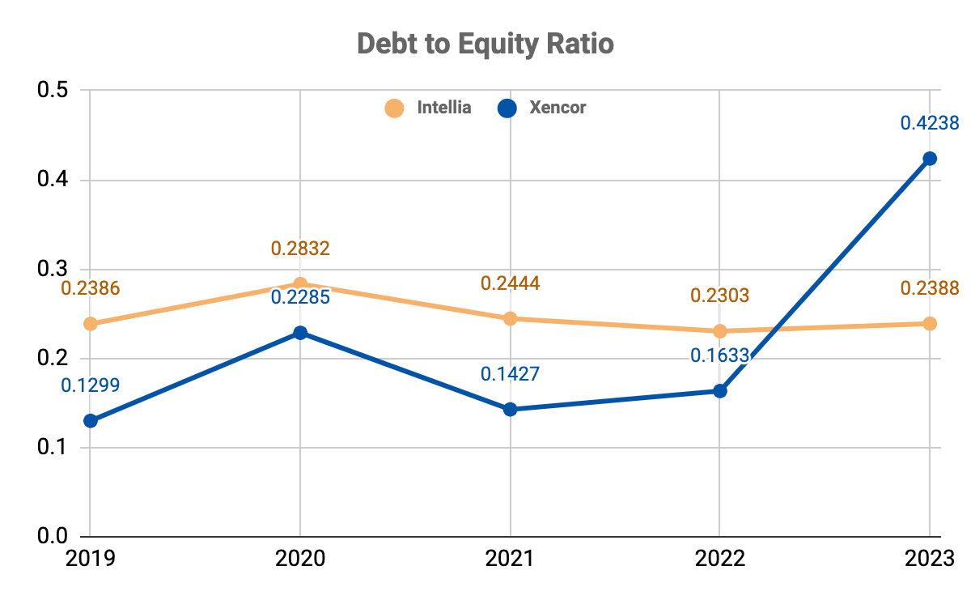
XENCOR’S DEBT SPIKE
4/5
3/5
Debt to Equity
Efficiency Optimization
Patient Value
Financial Stability
Principled Leadership
Sustainability Stewardship
Notes:
Key(which company)
Bulletin point - why it is important
Why 2023 ratio is so high for xencor
A measure of financial wellness
Maintaining long-term stability
Xencor has dramatically increased rate in 2023 due to the increase of deferred income

Slide 22
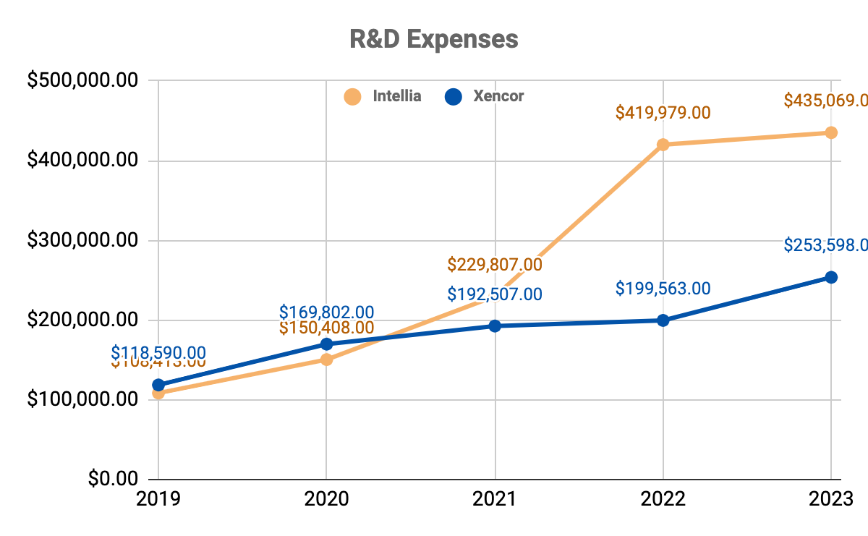
INTELLIA INCREASES R&D
2/5
4/5
Efficiency Optimization
Patient Value
Financial Stability
Principled Leadership
Sustainability Stewardship
Notes:
TITLES
What is the ratio
Add a key take away
Needs a point why this is relevant
Tell a story

Slide 23
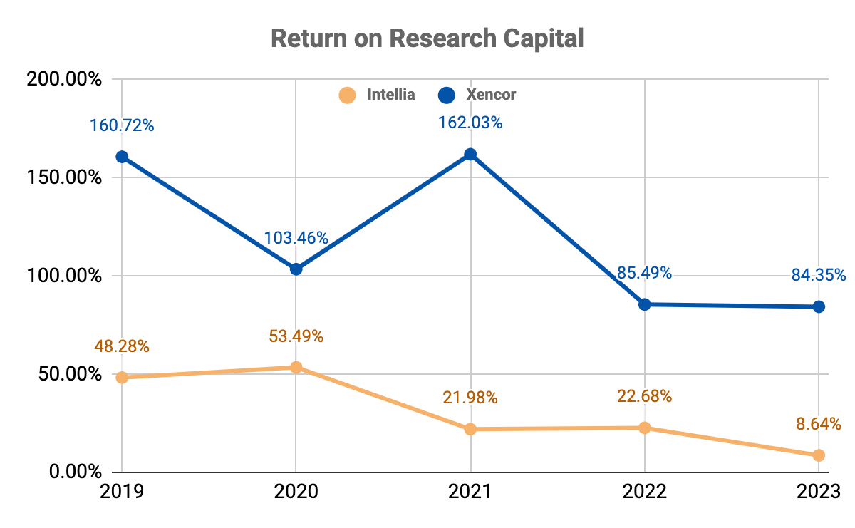
INTELLIA’S RETURN DECLINES
2/5
2/5
4/5
Efficiency Optimization
Patient Value
Financial Stability
Principled Leadership
Sustainability Stewardship
Notes:
The effectiveness of using shareholder’s money to generate profits
Reaches highest point in 2021 due to pandemic
Xencor has high RORC ratio but Intellia is more stable
Intellia less profitable bc more niche and less collaborators for research

Slide 24
FINANCIAL STABILITY SCORE
Debt to Equity
4/5
3/5
Research & Development
2/5
4/5
RORC
2/5
4/5
Total
2.6/5
3.7/5
Efficiency Optimization
Patient Value
Financial Stability
Principled Leadership
Sustainability Stewardship
Notes:
Change names of metrics
Change scoring
Financial stability

Slide 25

04
PRINCIPLED LEADERSHIP
Efficiency Optimization
Patient Value
Financial Stability
Principled Leadership
Sustainability Stewardship

Slide 26
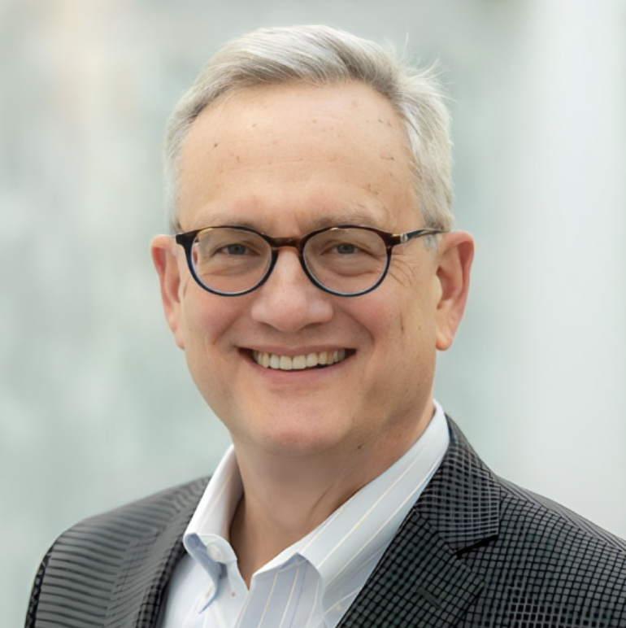
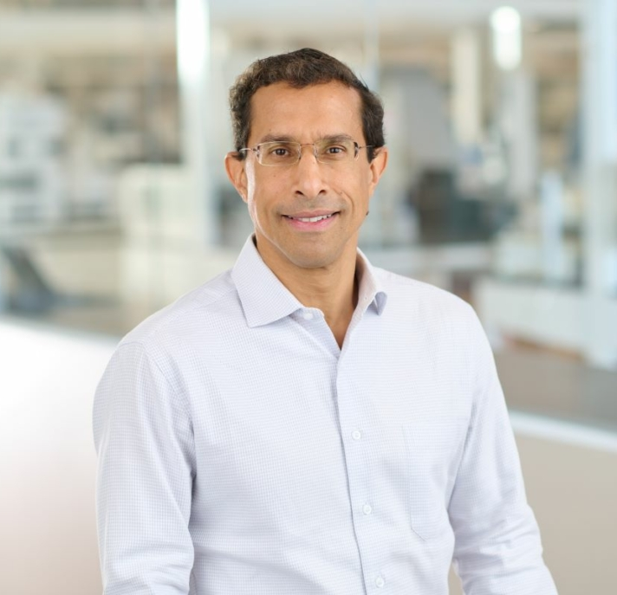
x/5
DIVERSITY = CREATIVITY
4/5
3.5/5
4/5
54%
Women in Leadership
33%
Women in Leadership
31%
Ethnically Diverse
58%
Ethnically Diverse
John Leonard
President & CEO
Basil I. Dahiyat
President & CEO
Efficiency Optimization
Patient Value
Financial Stability
Principled Leadership
Sustainability Stewardship
Notes:
Leading success, in their culture

Slide 27

THE PROMISE
Code of Business Conduct and Ethics
Dealing ethically and fairly leads to long term success
Open door policy
Safety standards
Commitment to stakeholders
Commitment to fairness
Efficiency Optimization
Patient Value
Financial Stability
Principled Leadership
Sustainability Stewardship
Notes:
Outlines the details that they expect from their employees
Decision makers and blind spots- biases

Slide 28
UNVEILING THE REALITY
x/5
x/5
2/5
15% of employees laid off in 2021
“Announced a massive layoff via text message… Board of Directors do not care anything about subordinates and employees”
Intellia Associate
Poor communication with employees
Time pressure to perform with financials
Focused on surviving and not the values
Eroded trust with employees decreasing morale and productivity
Efficiency Optimization
Patient Value
Financial Stability
Principled Leadership
Sustainability Stewardship
Notes:
https://www.glassdoor.com/Reviews/Intellia-Therapeutics-layoff-Reviews-EI_IE1410664.0,21_KH22,28.htm
Xencor
Picture
On the right put b
Directly contradicts objectives
Cost benefit
Culture - fast paced, funding, competitors
Something else is going on in the industry but it isn’t affecting them why?
Blind spot and biases
The ethics and technology

Slide 29
UNVEILING THE REALITY
4/5
“Death in Cancer Drug Trial
Hinders Xencor's Shares”
BIASES
Overconfidence bias could lead to underestimating risks with their drug candidate.
Recency bias might cause the company to overemphasize recent trial data.
Shares traded lower after a case of mortality was disclosed in a mid-stage trial in February of 2024
“We have looked across the entire program and we don’t see anything concerning relating hepatitis”
Investors downgraded biotech
Efficiency Optimization
Patient Value
Financial Stability
Principled Leadership
Sustainability Stewardship
Notes:
*****Bold the quote
Could be condensed
On the right put b
Directly contradicts objectives
Cost benefit
Culture - fast paced, funding, competitors
Something else is going on in the industry but it isn’t affecting them why?
Blind spot and biases

Slide 30
PRINCIPLED LEADERSHIP SCORE
Leadership
3.5/5
4/5
Realities
2.5/5
4/5
Total
3/5
4/5
Efficiency Optimization
Patient Value
Financial Stability
Principled Leadership
Sustainability Stewardship
Notes:
Change names of metrics
Change scoring
Financial stability

Slide 31

05
SUSTAINABILITY STEWARDSHIP
Efficiency Optimization
Patient Value
Financial Stability
Principled Leadership
Sustainability Stewardship

Slide 32
GREENING BIOTECH’S FUTURE
4/5
1/5
Gold LEED Certification
Sustainable lab equipment
Waste programs
EV stations/Public transit
130k sq. ft. facility
No sustainability practices
Efficiency Optimization
Patient Value
Financial Stability
Principled Leadership
Sustainability Stewardship
Notes:
Energy
Gold LEED Certification
Invests in sustainable lab equipment
Waste
Recycling and composting
Plasticware removal
Transportation
Public transit benefits
Access to EV charging stations
No stats for intellia so theres concerns for greenwashing = 3/5

Slide 33
BUILDING STRONGER COMMUNITIES
4/5
0/5
Educational partnerships
Philanthropy
Employee volunteering
No reported social initiatives
2 deaths in past 5 years
Efficiency Optimization
Patient Value
Financial Stability
Principled Leadership
Sustainability Stewardship
Notes:
Educational
Science kit assembly
United Negro College Fund partnership
40k donated last year
STEM student hosting
Local
2 blood drives
9 community partnerships
Over 100 employees volunteering at 10+
Product safety
Patient death related with XmAb14045(2019)
Death in Cancer drug trial(2023)

Slide 34
SUSTAINABILITY STEWARDSHIP SCORE
Environmental
4/5
1/5
Social
4/5
0/5
Total
4/5
0.5/5
Efficiency Optimization
Patient Value
Financial Stability
Principled Leadership
Sustainability Stewardship
Notes:
Change names of metrics
Change scoring
Financial stability

Slide 35
INVESTMENT INSIGHT
Companies | Efficiency Optimization (30%) | Patient Value (20%) | Financial Stability (25%) | Principled Leadership (15%) | Sustainability Stewardship (10%) | Total Grade
 | 3.5 | 2.7 | 2.6 | 3 | 4 | 3.1/5
 | 3.8 | 3.8 | 3.7 | 4 | 0.5 | 3.5/5

Slide 36
Thank you!
Any Questions?

Slide 37
BIBLIOGRAPHY
Websites:
- Xencor Official Website. (https://xencor.com/)
- Xencor About Us. (https://xencor.com/about-us/#management)
- Xencor Investors Relations - Financials and Filings. (https://investors.xencor.com/financials-and-filings)
- Xencor Investors Relations - Corporate Governance. (https://investors.xencor.com/corporate-governance)
- Alexion Pharmaceuticals Official Website. (https://alexion.com/our-company/about-us)
- Genentech Official Website. (https://www.gene.com/about-us)
- Incyte Official Website. (https://incyte.com/who-we-are/biopharmaceutical-research)
- Amgen Official Website. (https://www.amgen.com/about)
Patents:
- Intellia Therapeutics Inc. Patents. (https://patents.justia.com/assignee/intellia-therapeutics-inc)
- Intellia Therapeutics Inc. Investor Relations - SEC Filings. (https://ir.intelliatx.com/static-files/10e6a1dc-d626-44ad-b184-fe0e149189e7)
- Endpoints News - Building on CRISPR Success: Intellia Inks Deal for New Manufacturing Facility in Waltham, MA. (https://endpts.com/building-on-crispr-success-intellia-inks-deal-for-new-manufacturing-facility-in-waltham-ma/)
- Xencor Investors Relations - Annual Reports. (https://investors.xencor.com/financials-and-filings/annual-reports)
- Business Source Ultimate - Article. (https://web-p-ebscohost-com.ezproxy.bu.edu/bsi/pdfviewer/pdfviewer?vid=5&sid=2855e5f6-6b88-4a50-9fb7-b4cde232aab6%40redis)
- Seeking Alpha - Xencor Stock Slips as Piper Cuts Patient Death Study. (https://seekingalpha.com/news/4073328-xencor-stock-slips-as-piper-cuts-patient-death-study)
- Glassdoor - Xencor Reviews. (https://www.glassdoor.com/Reviews/Xencor-Reviews-E34743.htm)
- Los Angeles Business Journal - Xencor Stock Information. (https://labusinessjournal.com/finance/stocks/xencor/)

